Slide 1

Telecom Customer Churn Prediction
By:
Tejaswini Kavuri (CM12215)
Guided By:
Prof. Chaojie Wang
Spring 2024

Slide 2
Introduction
Telecom companies mainly rely on the customer retention for profits and maintaining the revenue.
The main goal is to predict the Churn rate, the rate at which the customer discontinue the telecom service.
By identifying this churners, these companies will take the pro-active measures to reduce the revenue loss and to retain customers.

Slide 3
Importance
Customer Trust and Satisfaction
Cost efficiency to retain the existing customers
For long-term stability of the business

Slide 4
Research Questions
Can we identify these Churn early using by any measures ?
How accurate we can predict the churn rate using the machine learning prediction models ?
Which model predicts the Churn rate effectively?

Slide 5
Dataset
Data sources:
The specific telecom customer churn https://www.mavenanalytics.io/blog/maven-churn-challenge
Kaggle link: https://www.kaggle.com/datasets/shilongzhuang/telecom-customer-churn-by-maven-analytics?select=telecom_customer_churn.csv
Size of the dataset is - 1.40 MB
Dataset contains 38 columns and 7,043 customer data in total.

Slide 6
Variables or Measures
Below are the variables I am considering for my analysis.
Customer ID
Gender
Age
Married
Number of Dependents
City
Zip Code
Latitude
Longitude
Number of Referrals
Tenure in Months
Offer
Phone Service
Avg Monthly Long Distance Charges
Multiple Lines
Internet Service
Internet Type
Avg Monthly GB Download

Slide 7
Variables or Measures
Online Security
Online Backup
Device Protection Plan
Premium Tech Support
Streaming TV
Streaming Movies
Streaming Music
Unlimited Data
Contract
Paperless Billing
Payment Method
Monthly Charge
Total Charges
Total Refunds
Total Extra Data Charges
Total Long Distance Charges
Total Revenue
Customer Status
Churn Category
Churn Reason

Slide 8
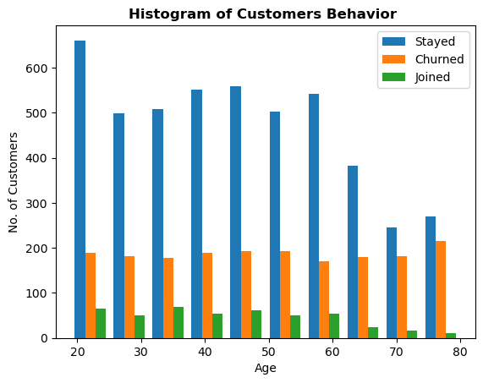
Exploratory Data Analysis

Slide 9
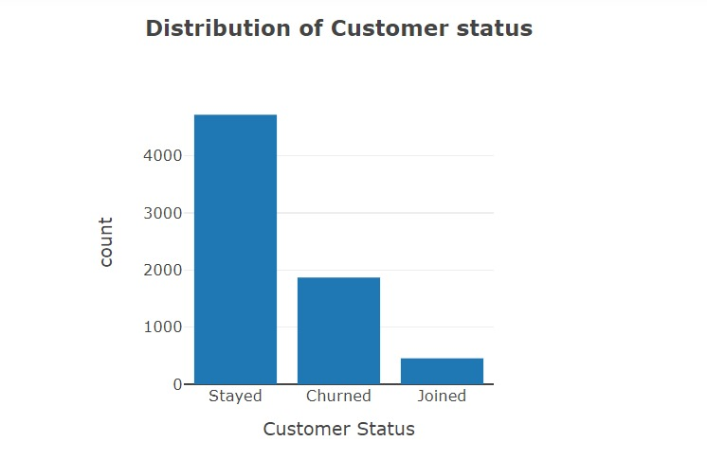
Exploratory Data Analysis

Slide 10
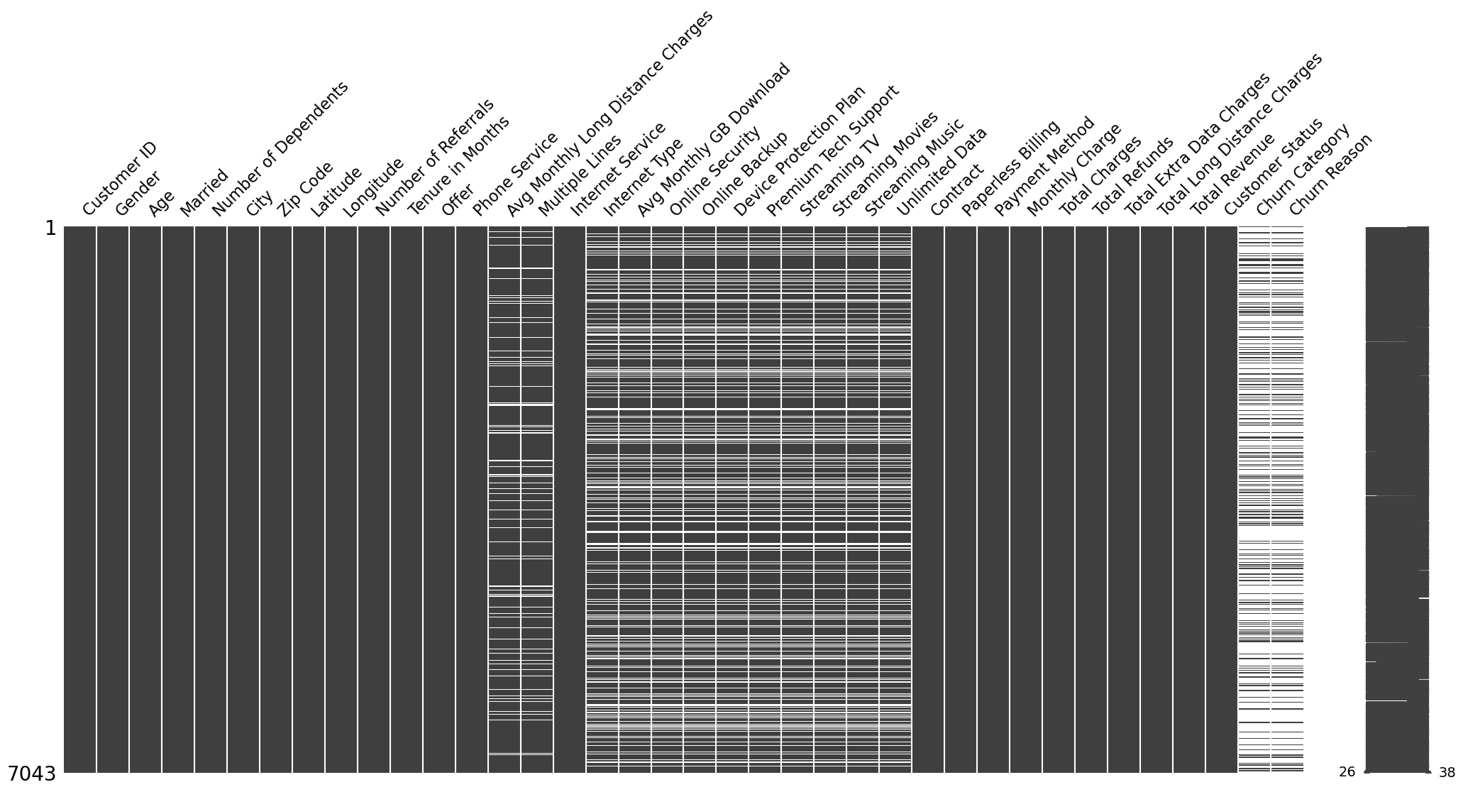
Null Value Classification

Slide 11
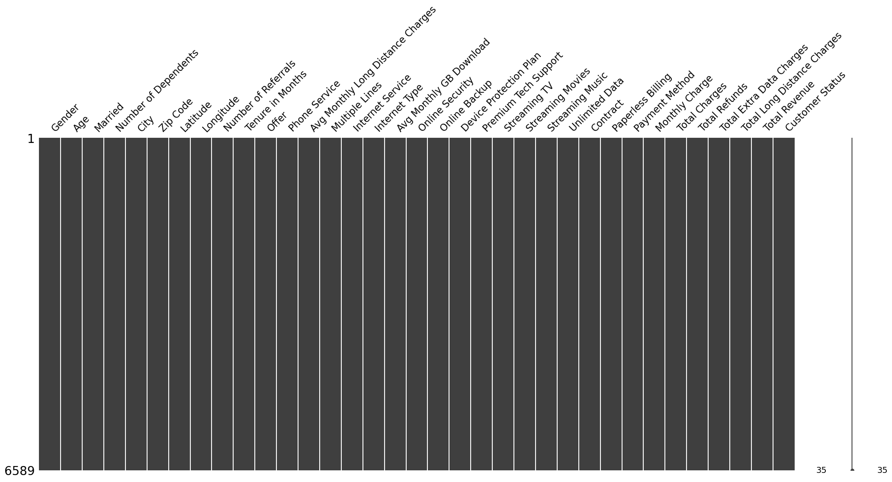
Null Value Classification

Slide 12
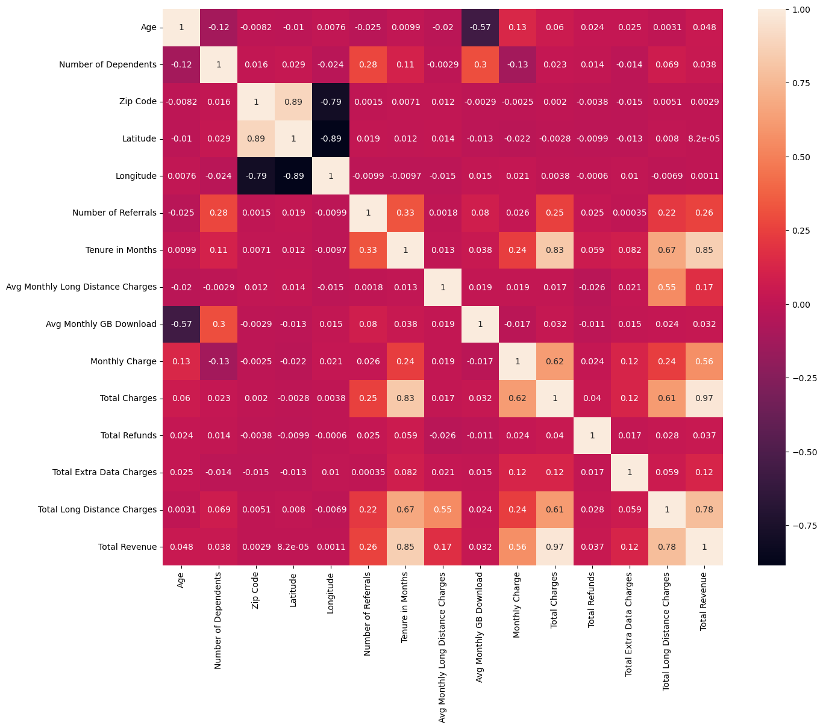
Correlation Matrix

Slide 13
Machine Learning Models
Random Forest Classifier
SVM
Logistic Regression

Slide 14
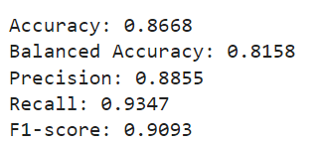
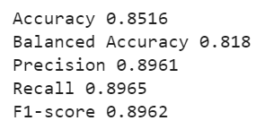
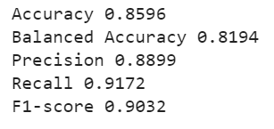
Results
Random Forest Classifier 3. Logistic Regression
SVM

Slide 15
Hyper Tuning
Random Search
Grid Search
Halving Random
Halving Grid

Slide 16
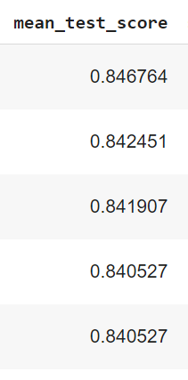
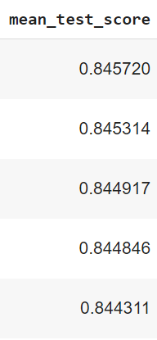
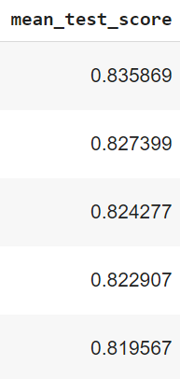
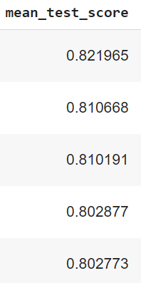
Hyper Tuning
Grid Search
Halving Random
Halving Grid
Random Search

Slide 17
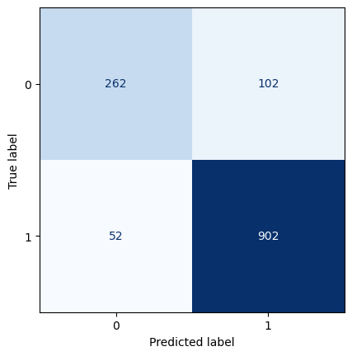
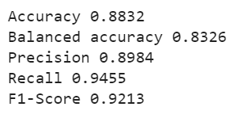
Accuracy For the best model test data
Best model Accuracy
Confusion Matrix

Slide 18
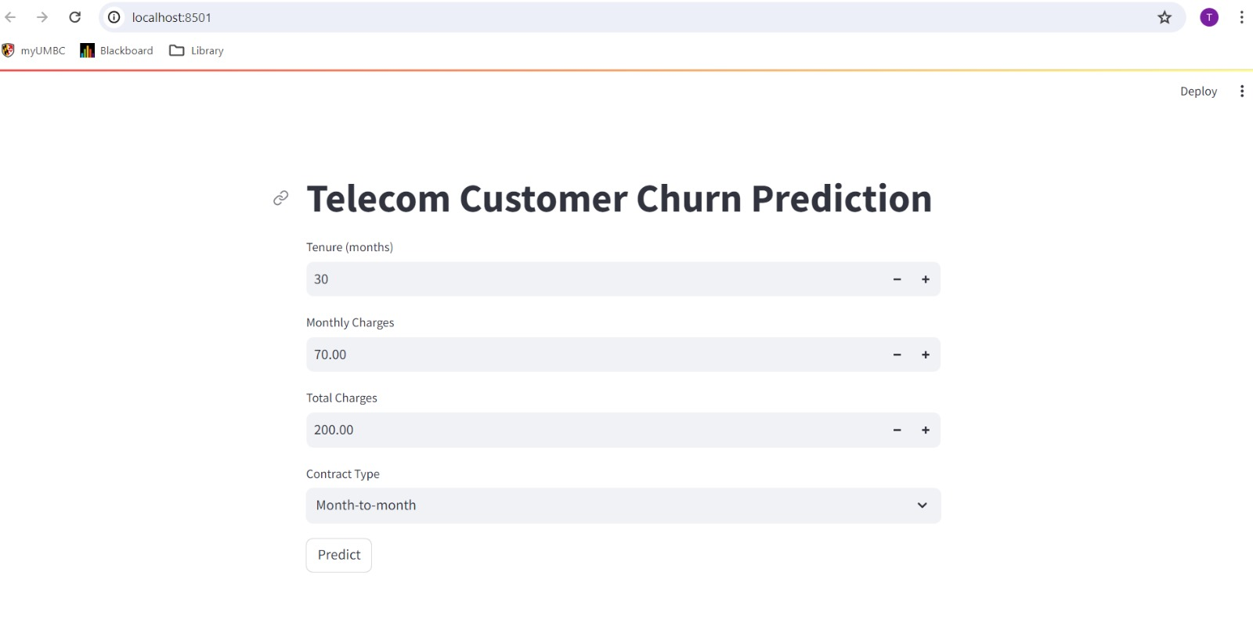
Stream Lit

Slide 19
Conclusion
Train Data Accuracy Test Data Accuracy
After running the best model on the test data, Random forest Classifier model gives the best accuracy.

Slide 20
THANK YOU

